Slide 1
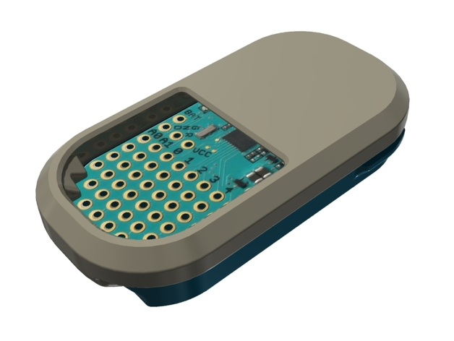
FAUX FIND ALL USERS ‘X’
GROUP 2: AMISH KANJI (CPE)
JOEL GARDYASZ (CPE)
JOSH RADICCHI (EE)

Slide 2
PROJECT MOTIVATION
People misplace items of value all the time
They also leave behind their laptops on their way to work
We want to create a product that prevents these things from happening
There are other similar products on the market right now
We want to learn from these implementations and make ours better

Slide 3
GOALS AND OBJECTIVES
To make it so that people don’t “freak out” when they misplace or leave something behind
They will know that they can track it using FAUX
To create a device that is easy to use
To create a mobile application that enables the user to locate their device and the belonging that it was attached to

Slide 4
REQUIREMENTS AND SPECIFICATIONS
Component | Requirement
Application | The location of the object will be found by using a smartphone or tablet.
Case | The tracking device will be of portable size and weight.
Case | The tracker will be water resilient, and be able to withstand fall damage.
Application | Your smartphone will respond to the tracker if need be.
Speaker/LED | The tracker will produce sounds and light up when prompted.
Bluetooth | The tracker will work well up to 20 feet.
Bluetooth | The tracker will notify the user if the item being tracked gets too far away from the user.

Slide 5
WORK DISTRIBUTION
Amish – Red
Josh – Green
Joel – Blue

Slide 6
WIRELESS COMMUNICATION
Bluetooth (BLE & iBeacon)
Advantages: Low Battery Consumption, cheap, low latency, integration, range
Disadvantages: Data Rate, strength of signal, receiver battery life, receiver
Wi-Fi
Advantages: Cheap, high data rate, integration, range
Disadvantages: Security, battery consumption, strength of signal
GPS
Advantages: Cheap, integration, range
Disadvantages: Battery consumption, indoor capability, inaccuracy

Slide 7
BLUETOOTH LOW ENERGY (BLE)
Advantages
Has a range of up to 50 feet away.
Has reduced energy consumption.
Very cost effective.
Stays on in the background.
Disadvantages
The signal strength is not always the strongest.
Does not have a high bandwidth.

Slide 8
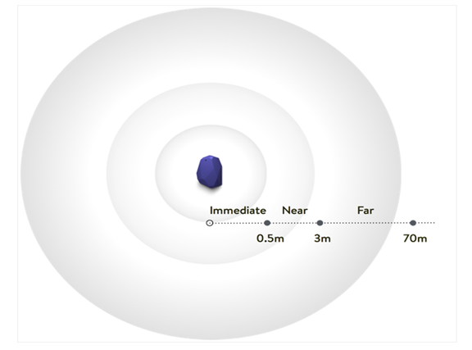
IBEACON
What is iBeacon?
Protocol developed by Apple, referred to as beacons
Broadcast identifier to nearby devices which causes some action
Uses Bluetooth Low Energy
Why iBeacon?
No other product uses this technology
Always broadcasting
No syncing requirement

Slide 9
ESTIMOTE
Top companies for beacons
What are Estimote Beacons?
Small wireless sensors
Broadcast radio signals
Devices interpret unlocking micro-location and contextual awareness
Why Estimote?
Estimote SDK
Requirements
Tutorials/community

Slide 10
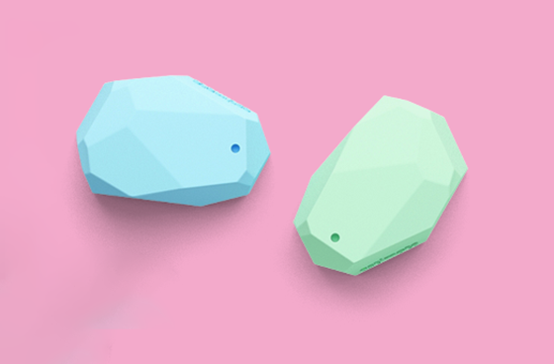
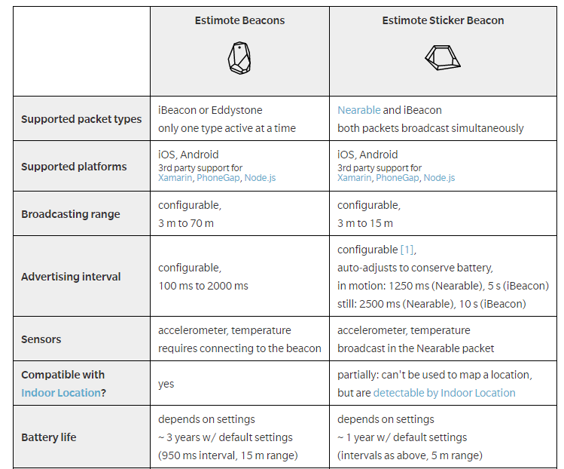
ESTIMOTE BEACONS VS ESTIMOTE STICKERS

Slide 11
ESTIMOTE STICKER
Why Estimote Sticker Beacons?
Size (3 mm thin)
Easier to stick to everyday objects
How are Stickers different?
Packets
More information
iBeacon/Nearables
Examples: ID, motion, power, voltage, temperature
Manufacturer | Estimote
Product | Sticker Beacons
Price | $99
Quantity | 10

Slide 12
PUNCH THROUGH
Small hardware company
Creator of the Light Blue Bean
Uses Arduino to program the Bean wirelessly
Uses BLE to wirelessly communicate
Why Punch Through?
Has a development board that
has meets all of our technical and
size constraints.
They sell some of the parts separately

Slide 13
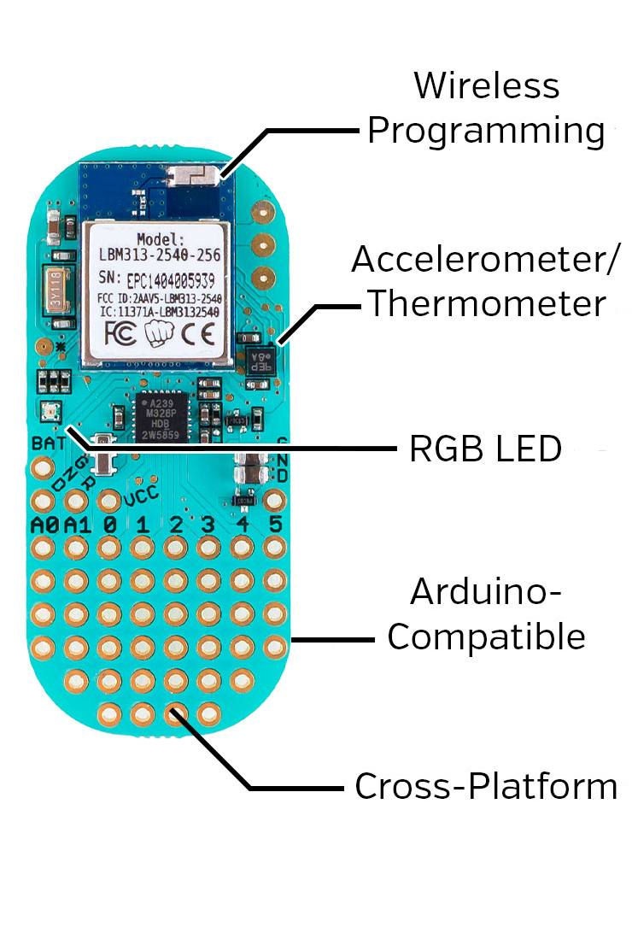
LIGHT BLUE BEAN
Development board
BLE enabled
Programmable pins
Small
Battery Powered
Manufacturer | Punch Through
Product | Light Blue Bean
Price | $29.95
Quantity | 1

Slide 14
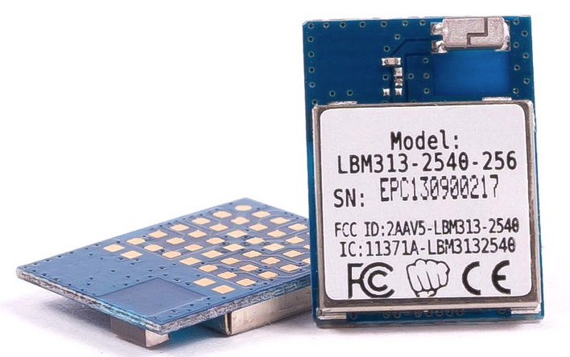
CHOSEN BLE MODULE
LBM313
Key Features:
2.4Ghz Bluetooth low energy
Data rates from 250kbps to 1mbps
Programmable output power
Operating voltage of 2.0V - 3.6V
8051 microcontroller with 256kB of in
system programmable flash and 8kB of
RAM
Manufacturer | Punch Through
Product | LBM 313
Price | $8.95
Quantity | 1

Slide 15
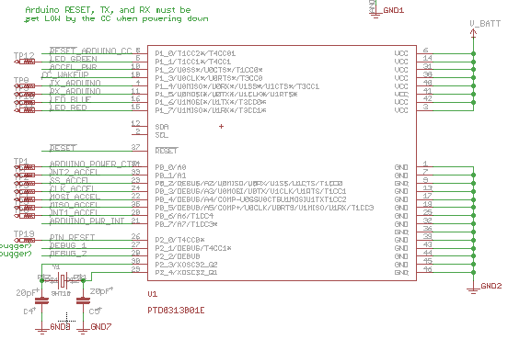
PCB LAYOUT OF BLE MODEL

Slide 16
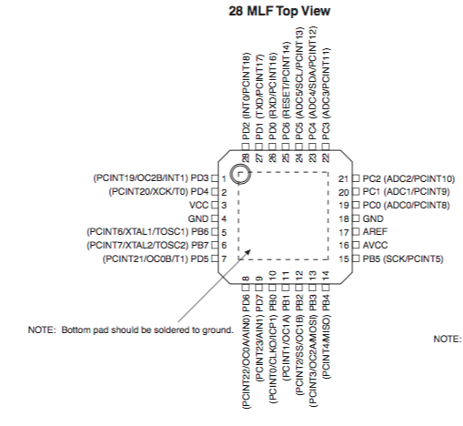
CHOSEN MICROCONTROLLER
ATMEGA328
Low-power CMOS 8-bit
microcontroller.
Based on the AVR enhanced RISC
architecture.
Allows the system designer to
optimize power consumption

Slide 17
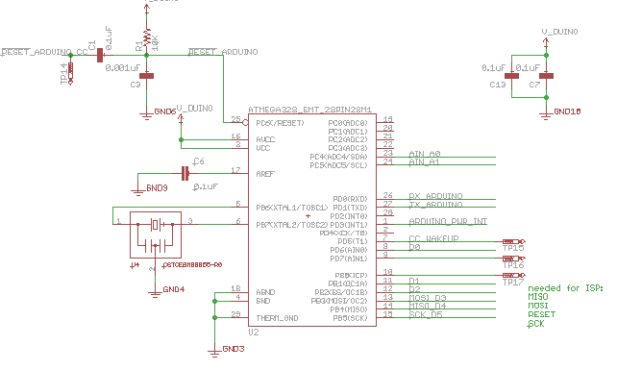
PCB LAYOUT OF MICROCONTROLLER

Slide 18
WIRING OF THE LIGHT BLUE BEAN

Slide 19
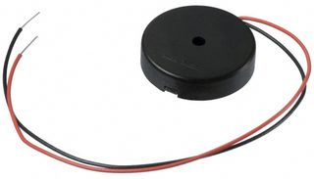
CHOSEN SPEAKER
The speaker’s purpose is to aid the user in locating the device if they are nearby
It adds an auditory component for tracking
We could not use a standard magnetic driven speaker
This would require the addition of an amp which is too big for our design
Manufacturer | Multicomp
Product | Piezo buzzer
Price | $3
Quantity | 1

Slide 20
CHOSEN SPEAKER
Therefore we decided to go with a piezoelectric speaker
The piezo does not need a magnet to produce sound
Creates sound by passing electric charge through a crystal
Uses a lot less energy
More resistant to breaking
Manufacturer | Multicomp
Product | Piezo buzzer
Price | $3
Quantity | 1

Slide 21
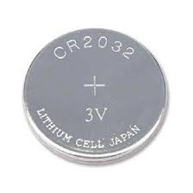
CHOSEN BATTERY
CR2032 (coin cell battery)
Lithium battery
3V
Manufacturer | Energizer
Product | CR2032
Price | $3.49
Quantity | 1

Slide 22
LED
We will be using a RGB LED
Used to find item in the dark
You will get your choice of 3 different colors

Slide 23
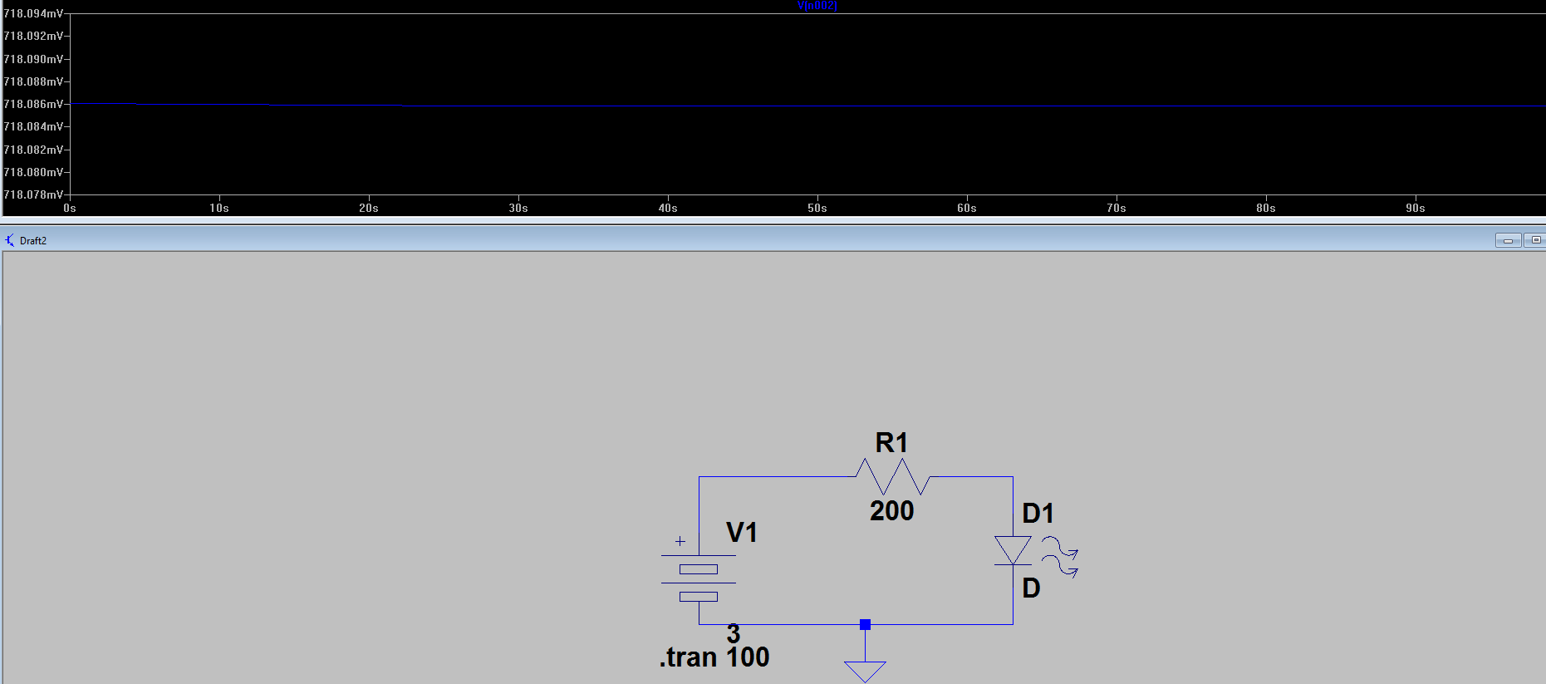
718 mV

Slide 24
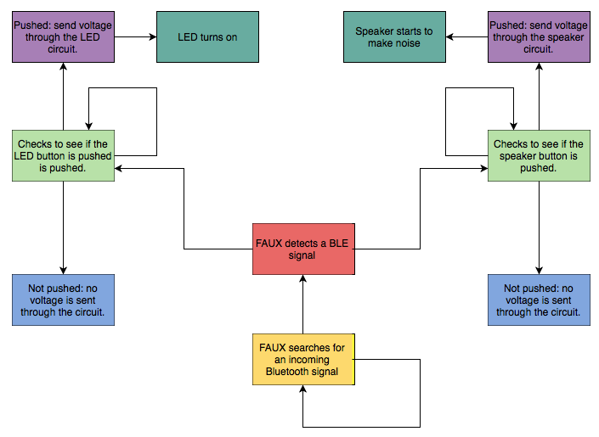
PUT IT TOGETHER

Slide 25
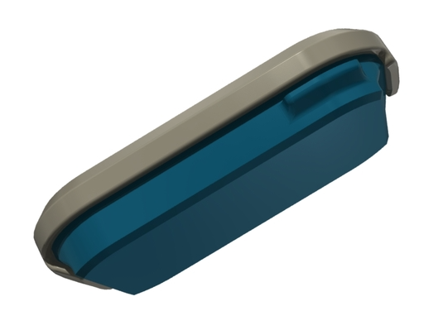
PROTECTIVE CASE
3D printed using ABS plastic
Water resistant
Durable
Customizable

Slide 26
HARDWARE – SUCCESS AND DIFFICULTIES EXPECTED
Success
Finding a dev board that fits our technical and size constraints.
Building a case that is protective against the elements
Difficulties
Recreating the dev board to use for our purposes.
Keeping everything as small as possible.

Slide 27
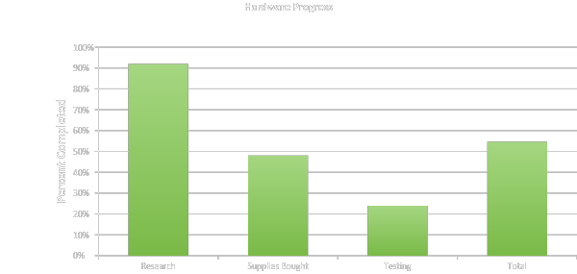
HARDWARE- CURRENT PROGRESS
Just over 50% done with the total hardware progress

Slide 28
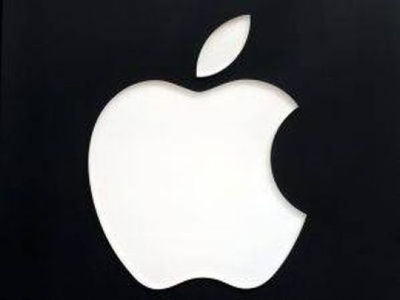
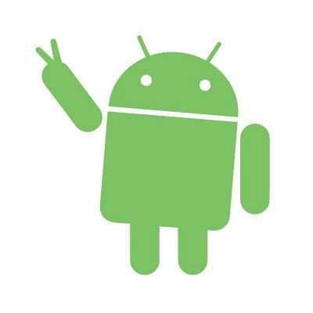
MOBILE APPLICATION – ANDROID VS IOS
>
Practicality
Testing/Debugging
Compatibility
Estimote
Written in Swift, less code than Java
Offline guide and API reference

Slide 29
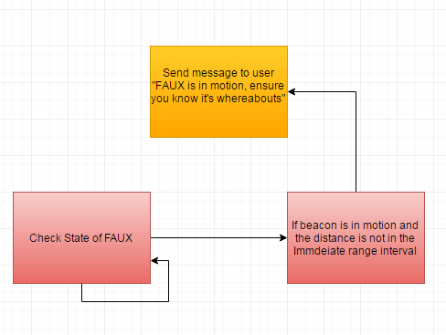
MOBILE APPLICATION - NOTIFICATIONS
Reminders
Alerts

Slide 30
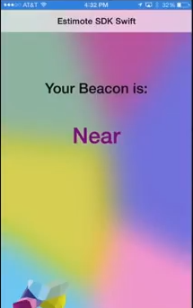
MOBILE APPLICATION – PRIMARY FUNCTION
Tracking
Ranging/Monitoring
Hotter/Colder
User friendly messages/guidance will need to be added

Slide 31
MOBILE APPLICATION – PRIMARY FUNCTION

Slide 32
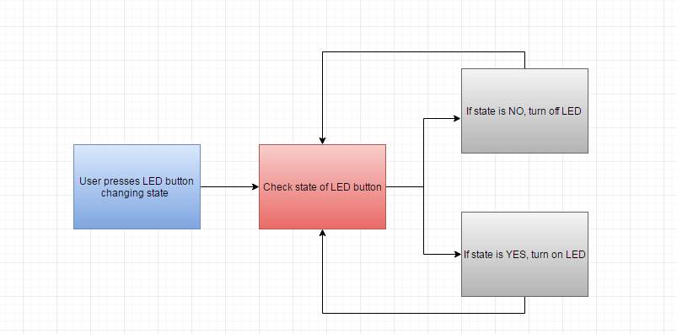
MOBILE APPLICATION – SECONDARY FUNCTIONS

Slide 33
TESTING FAUX

Slide 34
SOFTWARE – CURRENT PLAN/PROGRESS
Xcode
Swift
Fluent
Cocoapods
Third party libraries
~50% done

Slide 35
SOFTWARE – SUCCESS AND DIFFICULTIES EXPECTED
Success
User friendly mobile application
Negligible learning curve
Features can be successfully completed
No issues occur when in correct range
End goal is achieved without any errors
Difficulties
Testing
Obstacles
Environment
Distance
Out of date technology
Ranging/Monitoring
Signal dependent

Slide 36
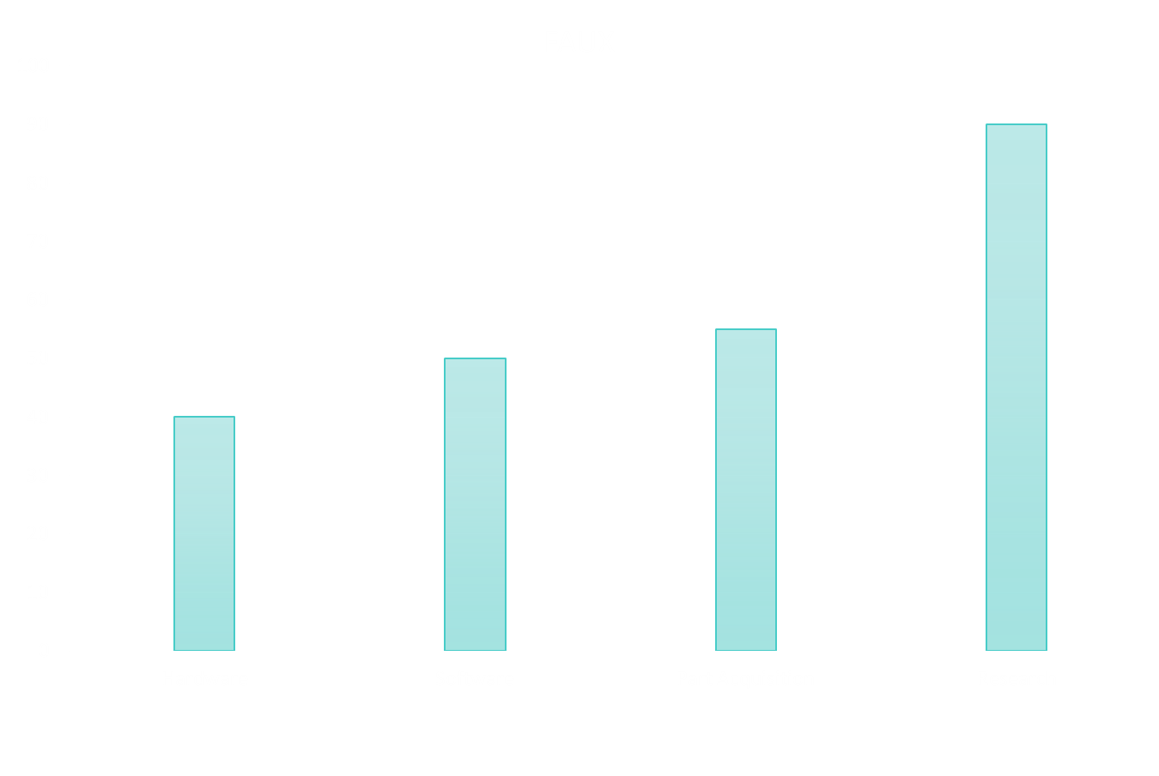
TOTAL PROJECT PROGRESS
Software
Hardware
Parts
Total: ~45%

Slide 37
BUDGET AND FINANCING
Part | Cost Per Unit | Quantity | Total Cost
iOS Device | Already Owned | 1 | $0.00
LightBlue Bean | $30.00 | 1 | $30.00
Casing (3D printed) | $30.00 | 1 | $30.00
Speaker | $3.00 | 1 | $3.00
Estimote Sticker Beacons | $100.00 | 10 | $100.00
LBM 313 | $9 | 1 | $9.00
Wires | Already Owned | 2 feet | $0.00
Misc. Supplies/Tools | $50.00 | NA | $50.00
Total Cost |  |  | $213.00
Most of the materials for the project were either already owned by someone in the group or were relatively inexpensive
Therefore, the entire project was funded by the members of the group

Slide 38
TIMELINE
Week of | Task Description
 | Senior Design I (Spring)
1/11/16 | Project Introduction
1/18/16 | Group Formation
1/25/16 | Initial Project Proposal
2/1/16 | Research Bluetooth
2/8/16 | Research iBeacon Device
2/15/16 | Research Microcontroller
2/22/26 - 2/29/16 | Continue researching and begin design document
3/7/16 | Spring Break
3/14/16 - 3/28/16 | Design models and continue design paper
4/4/16 - 4/18/16 | Finalize paper and being ordering parts
 | Senior Design II (Summer)
5/16/16 | Discuss plans/go over inventory
5/23/16 - 6/6/16 | Design and test app
6/13/16 - 7/4/16 | Prototype microcontroller and iBeacon device
7/11/16 - 7/25/16 | Test and debug system/being final documents
8/1/16 | Final Presentation/Evaluation

Slide 39
QUESTIONS?

